Slide 1
LAB1:房價預測
106368401 江建勳

Slide 2
作業要求
用回歸模型做房價預測
用train.csv跟valid.csv訓練模型
將test.csv中的每一筆房屋參數，輸入訓練好的模型，預測其房價
將預測結果上傳，看系統幫你算出來的分數夠不夠好
嘗試改進預測模型

Slide 3
程式流程
讀取資料
正規化
網路模型
數值預測
結果觀察

Slide 4
讀取資料
data_1=pd.read_csv('train-v3.csv')
X_train=data_1.drop(['price','id'],axis=1).values
Y_train=data_1['price'].values
data_2=pd.read_csv('valid-v3.csv')
X_valid=data_2.drop(['price','id'],axis=1).values
Y_valid=data_2['price'].values
data_3=pd.read_csv('test-v3.csv')
X_test=data_3.drop('id',axis=1).values

Slide 5
正規化
def normalize(train,valid,test):
tmp=train
mean=tmp.mean(axis=0)
std=tmp.std(axis=0)
print("tmp.shape=",tmp.shape)
print("mean.shape=",mean.shape)
print("std.shape=",std.shape)
print("mean=",mean)
print("std=",std)
train=(train-mean)/std
valid=(valid-mean)/std
test=(test-mean)/std
return train,valid,test
X_train,X_valid,X_test=normalize(X_train,X_valid,X_test)

Slide 6
網路模型
model=Sequential()
model.add(Dense(50,input_dim=21,init='normal',activation='relu'))
model.add(Dense(116,input_dim=50,init='normal',activation='relu'))
model.add(Dense(158,input_dim=116,init='normal',activation='relu'))
model.add(Dense(144,input_dim=158,init='normal',activation='relu'))
model.add(Dense(90,input_dim=144,init='normal',activation='relu'))
model.add(Dense(60,input_dim=90,init='normal',activation='relu'))
model.add(Dense(1 ,init='normal'))
model.compile(loss='mean_squared_error',optimizer='adam')
model.fit(X_train,Y_train,batch_size=20,nb_epoch=210,validation_data=(X_valid,Y_valid))

Slide 7
數值預測
Y_predict=model.predict(X_test) #test data pred price
valid_predict=model.predict(X_valid) #valid data true price
train_predict=model.predict(X_train) #train data true price

Slide 8
結果觀察
plt.figure()
plt.scatter(Y_train, train_predict , c='r')
MAE_train = mean_absolute_error(Y_train, train_predict)
print("\n")
print (MAE_train)
plt.figure()
plt.scatter(Y_valid, valid_predict )
MAE_valid = mean_absolute_error(Y_valid, valid_predict)
print("\n")
print (MAE_valid)

Slide 9
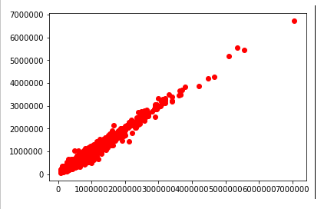
圖表分析
X軸為實際房價
Y軸為預測房價
點越集中x=y線上，預測越精準

